Slide 1
Java Programming
Numerical Data

Slide 2
Objectives
    Select proper types for numerical data.
    Write arithmetic expressions in Java.
    Evaluate arithmetic expressions using the precedence rules.
    Write mathematical expressions, using methods in the Math class.
    Generate pseudo random numbers.
    Use the GregorianCalendar class in manipulating date information such as year, month, and day.
    Use the DecimalFormat class to format numerical data
    Input and output numerical data by using System.in and System.out

Slide 3
Primitive vs. Reference
Numerical data are called primitive data types.
Objects are called reference data types, because the contents are addresses that refer to memory locations where the objects are actually stored.

Slide 4
Primitive Data Types
Integer types
  byte (1 byte signed)
  short (2 bytes signed)
  int (4 bytes signed)
  long (8 bytes signed) use suffix L (eg 1000000000L)
Floating-point types
  float (4 bytes) use suffix F (eg 1.28F)
  double( 8 bytes)
char
  Two-byte unicode (16 bits, but stored in one 32-bit word)
  Assignment with ‘ ’ e.g. char c = ‘h’;
boolean
  true or false e.g. boolean x = true;
    if (x){…};
Notes:
Number Literals
int i = 34;
long l = 1000000;
float f = 100.2f;
or
float f = 100.2F;
double d = 100.2d
or
double d = 100.2D;

Slide 5
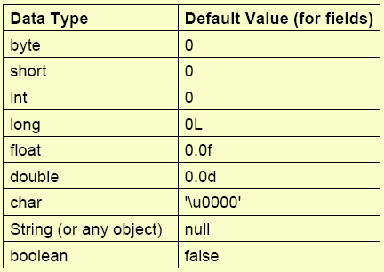
Data Type’s Default Values
5

Slide 6
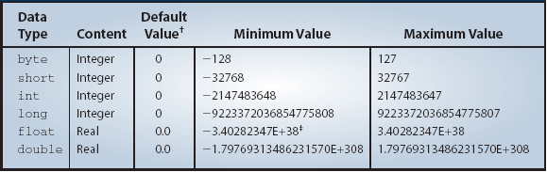
Data Type Precisions
The six data types differ in the precision of values they can store in memory.
Notes:
This is for information only. You do not have to memorize this table. Just get some general idea on the range of values that can be represented by the six numerical data types.

Slide 7
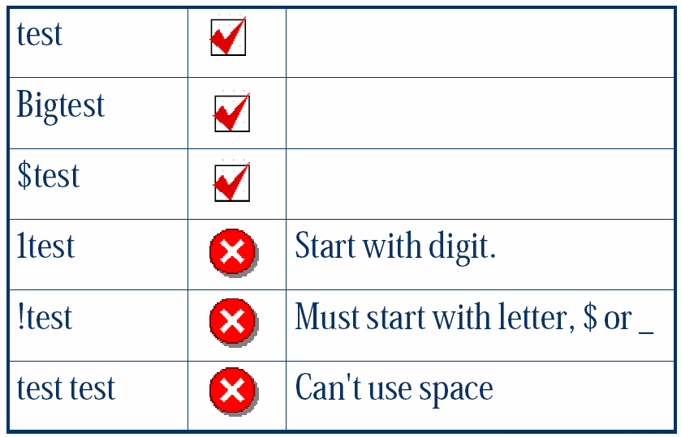
Identifier
Identifier is a word used by a programmer to name a variable, method, class.
Must begin with a letter (a-z), a dollar sign ($), or an underscore ( _ )
Subsequent characters may be letters, dollar signs, underscores, or digits.
Don’t use keywords and reserved words (e.g., class, static, int, etc..)
The following are legal identifiers:
  Dummy
  box$
  A37
  post_code
The following are not legal identifiers:
  rain@noon
  2by4
  post code

Slide 8
Identifier(cont’d)
Case is significant:
  identifiers Abc, aBc and abC are different
Identifiers cannot contain special operation symbols like +, -, *, /, &, %, ^, etc.
An identifier cannot be true, false, or null.
An identifier can be of any length.
Names of variables usually start with a lowercase letter.

Slide 9
Java Keywords &Reserved Words
abstract | assert | boolean | break | byte
case | catch | char | class | const
continue | default | do | double | else
extends | final | finally | float | for
goto | if | implements | import | instanceof
int | interface | long | native | new
package | private | protected | public | return
short | static | strictfp | super | switch
synchronized | this | throw | throws | transient
try | void | violate | while
goto and const are reserved: Although they have no meaning in Java.

Slide 10
Expressions
Variables and constants are used in expressions to define new values and to modify variables.
Expressions involve the use of literals, variables, and operators
Literals:
A literal is any “constant” value that can be used in an assignment or other expression.
  null, true, false, integer value, floating point value,
  Character: a character is defined as an individual symbol enclosed in single quotes, ‘a’, ‘!’, ‘\n’….
  String literal: A String literal is a sequence of characters enclosed in double quotes, “EE205 Students”, “KAIST”.

Slide 11
Constants
Constants are similar to variables except that they hold a fixed value. They are also called “READ ONLY” variables.
Constants are declared with the reserved word “final”.
  final int MAX_LENGTH = 420;
  final double PI = 3.1428;
By convention , upper case letters are used for defining constants.

Slide 12
Variables
In Java, to add two numbers x and y, we write
x + y
When the declaration is made, memory space is allocated to store the values of x and y.
x and y are called variables. A variable has three properties:
      A memory location to store the value,
      The type of data stored in the memory location, and
      The name used to refer to the memory location.
Sample variable declarations:
  int x;
  int v, w, y;

Slide 13
Numerical Data Types
There are six numerical data types: byte, short, int, long, float, and double.
Sample variable declarations:
  int i, j, k;
    float numberOne, numberTwo;
    long bigInteger;
    double bigNumber;
At the time a variable is declared, it also can be initialized. For example, we may initialize the integer variables count and height to 10 and 34 as
int count = 10, height = 34;
Notes:
In the same way that you can initialize variables for numbers, you can initialize with objects. For example, instead of
JFrame myWindow;
myWindow = new JFrame();
we can write more succintly as
JFrame myWindow = new JFrame();

Slide 14
Assignment Statements
We assign a value to a variable using an assignment statements.
The syntax is
<variable> = <expression> ;
Examples:
sum = firstNumber + secondNumber;
avg = (one + two + three) / 3.0;
Notes:
To assign a value to a variable, we use an assignment statement. A single variable appears to the left of equal symbol and an expression appears to the right. Assignment statements are terminated by a semicolon.

Slide 15
Primitive Data Declaration and Assignments
int firstNumber, secondNumber;
firstNumber = 234;
secondNumber = 87;
A. Variables are allocated in memory.
firstNumber
234
A
int firstNumber, secondNumber;
int firstNumber, secondNumber;
secondNumber
firstNumber = 234;
secondNumber = 87;
87
firstNumber = 234;
secondNumber = 87;
B
B. Values are assigned to variables.
Code
State of Memory

Slide 16
Assigning Numerical Data
int number;
number = 237;
number = 35;
number
237
35
A. The variable is allocated in memory.
int number;
number = 237;
number = 35;
A
int number;
number = 237;
B
B. The value 237 is assigned to number.
number = 35;
C
C. The value 35 overwrites the previous value 237.
Code
State of Memory
Notes:
Notice how the old value is over written by the new value.

Slide 17
Assigning Objects
customer
Customer customer;
customer = new Customer( );
customer = new Customer( );
Customer
Customer
A
Customer customer;
customer = new Customer( );
customer = new Customer( );
B
A. The variable is allocated in memory.
Customer customer;
customer = new Customer( );
B. The reference to the new object is assigned to customer.
customer = new Customer( );
C
C. The reference to another object overwrites the reference in customer.
Code
State of Memory
Notes:
If the variable refers to an object, then the assignment and the corresponding effect to the memory allocation are different. Notice the content of the variable is not the value itself, as is the case with primitive data, but the address of, or reference to, the memory location where the object data is stored. We use arrows to indicate this memory reference.

Slide 18
Having Two References to a Single Object
Customer clemens, twain;
clemens = new Customer( );
twain = clemens;
clemens
twain
Customer
A
Customer clemens, twain,
clemens = new Customer( );
twain = clemens;
B
A. Variables are allocated in memory.
Customer clemens, twain;
clemens = new Customer( );
B. The reference to the new object is assigned to clemens.
twain = clemens;
C
C. The reference in clemens is assigned to customer.
Code
State of Memory
Notes:
This sample code shows the effect of two reference variables pointing to the same object, which is perfectly legal. This slide highlights the critical fact that the name (variable) and object are two distinct and separate entities. It is no problem to have multiple variables referring to a single object, much as a single person can be referred by many different names.

Slide 19
Variables: Scope
Each variable has a scope — the area in the source code where it is “visible.”
If you use a variable outside its scope, the compiler reports a syntax error.
Variables can have the same name when their scopes do not overlap.
{
int k = ...;
...
}
for (int k = ...)
{
...
}
Notes:
So scope is a compile-time concept, not a run-time concept. The compiler reports a syntax error, “Cannot resolve symbol.”
If the scopes of two variables overlap, the variable defined in the inner scope takes precedence over the variable with the same name in the outer scope. It is easy to make a mistake and override a field with a local variable of the same name, as explained later.

Slide 20
Type Casting
If x is a float and y is an int, what will be the data type of the following expression?
x * y
The answer is float.
The above expression is called a mixed expression.
The data types of the operands in mixed expressions are converted based on the promotion rules. The promotion rules ensure that the data type of the expression will be the same as the data type of an operand whose type has the highest precision.
Notes:
When an arithmetic expression consists of variables and constants of the same data type, then the result of the expression will be that data type also.
When the data types of variables and constants in an arithmetic expression are of different data types, then a casting conversion will take place. A casting conversion, or type casting, is a process that converts a value of one data type to another data type. Two types of casting conversions in Java are implicit and explicit. An implicit conversion called numeric promotion is applied to the operands of an arithmetic operator.

Slide 21
Explicit Type Casting
Instead of relying on the promotion rules, we can make an explicit type cast by prefixing the operand with the data type using the following syntax:
( <data type> ) <expression>
Example
(float) x / 3
(int) (x / y * 3.0)
Type case x to float and then divide it by 3.
Type cast the result of the expression x / y * 3.0 to int.
Notes:
We can always use the explicit type casting to change the data type of a value.

Slide 22
Implicit Type Casting
Consider the following expression:
double x = 3 + 5;
The result of 3 + 5 is of type int. However, since the variable x is double, the value 8 (type int) is promoted to 8.0 (type double) before being assigned to x.
Notice that it is a promotion. Demotion is not allowed.
int x = 3.5;
A higher precision value cannot be assigned to a lower precision variable.
Notes:
When the explicit type casting is not included in the expression, then the implicit type casting is applied when a value is assigned to a variable. This implicit assignment type casting will promote the value of the expression to a higher precision to match the data type of the variable. Demotion on precision will not occur implicit. You need the explicit type casting for demotion, for example,
int x = (int) 4.5 / 2.2;

Slide 23
Constants
We can change the value of a variable. If we want the value to remain the same, we use a constant.
final double PI = 3.14159;
final int MONTH_IN_YEAR = 12;
final short FARADAY_CONSTANT = 23060;
The reserved word final is used to declare constants.
These are constants, also called named constant.
These are called literal constant.
Notes:
The data type of literal constant 3.45 is double and the data type of literal constant 398 is int. To designate other data types for literal constants, we suffix the literal constants with the designators F or f for float and L or l for long. For example,
2.45f
1453L
Java convention uses all capitalized letters for constants.

Slide 24
Displaying Numerical Values
In Chapter 2, we showed how to output text (String) to the standard output
We use the same print and println methods to output numerical data to the standard output.
int num = 15;
System.out.print(num); //print a variable
System.out.print(“ “); //print a string
System.out.print(10); //print a constant
15 10

Slide 25
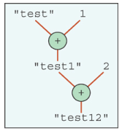
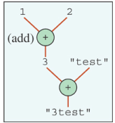
Overloaded Operator +
The plus operator + can mean two different operations, depending on the context.
<val1> + <val2> is an addition if both are numbers. If either one of them is a String, the it is a concatenation.
Evaluation goes from left to right.
output = “test” + 1 + 2;
output = 1 + 2 + “test”;
Notes:
Notice the long expression in the previous slide
"Given Radius: " + radius + "\n" +
"Area: " + area + "\n" +
"Circumference: " + circumference
with string literal constants and double variables. The plus symbol is an overloaded operator. In this expression, they are string concatenations.

Slide 26
Sample Code Fragment
//code fragment to input radius and output
//area and circumference
final double PI = 3.14159;
double radius, area, circumference;
//compute area and circumference
area = PI * radius * radius;
circumference = 2.0 * PI * radius;
System.out.println("Given Radius: " + radius);
System.out.println("Area: " + area);
System.out.println(" Circumference: “ + circumference);
Notes:
This code fragment accepts a radius as its input and outputs the circle’s area and circumference.

Slide 27
The DecimalFormat Class
Use a DecimalFormat object to format the numerical output.
double num = 123.45789345;
DecimalFormat df = new DecimalFormat(“0.000”);
//three decimal places
System.out.print(num);
System.out.print(df.format(num));
123.45789345
123.458
Notes:
When you print out a double value, you may get eight or nine decimal places. To limit the number of decimal places to display, you can use the DecimalFormat class.

Slide 28
Operators
primitive types support operators
  typically binary, but also unary and even ternary
  used in expressions
arithmetic operators
assignment operators
Increment /decrement operators
relational operators
logical operators
Notes:
+ - * / are used in Java for addition , subtraction, multiplication, division.
x += 4 is equivalent to x = x + 4;
double w = x*y/z;
Other Operators
+ (String concatenation)
instanceof (tests whether an object has certain type)
<<, >>, >>>, ~, &, |, ^
(bit pattern operations with numeric operands)
there are overloaded operators
e.g., +: unary sign, binary addition, String concatenation
operand type or usage decide meaning

Slide 29
Arithmetic Operators
+ Addition
- Subtraction
* Multiplication
/ Division
% Modulus
++ Increment
-- Decrement
+= Operator Assignments

Slide 30
Arithmetic Operators
-=
*=
/=
%=
  numeric operands, result is the more precise number type
      byte, short, int, long, float, double
    +, -, *, /, % (modulo)
    +, - (sign change, unary)

Slide 31
Arithmetic Operator
The precedence of operators and parentheses is the same as in algebra
Get the remainder with % (pronounced "modulo")
m % n means the remainder when m is divided by n
5 % 2 yields 1 (the remainder of the division)
% has the same rank as / and *
Same-rank binary operators are performed in order from left to right
/ is the division operator
If both arguments are integers, the result is an integer. The remainder is discarded .
5/2 yields an integer 2.
5.0/2 yields a double value 2.5
Notes:
There is also the unary operator -, for example,
sign = -sign;
All unary operators have a higher rank than binary operators and are executed first.

Slide 32
Increment & Decrement Operator
Prefix increment ++ e.g. ++i
Increase i by 1, then use the new value of i to evaluate the expression that i resides
Postfix increment ++ e.g. i++
Use the current value of i to evaluate the expression that i resides, then increase i by 1
Prefix decrement -- e.g. --i
Decrease i by 1, then use the new value of i to evaluate the expression that i resides
Postfix decrement -- e.g. i--
Use the current value of i to evaluate the expression that i resides, then decrease i by 1
int m = 7; int n = 7;
int a = 2* ++m; // a =16
int b = 2* n++; // b = 14
Notes:
<variable> <op> = < expression>
a[5] = 10;
i = 5;
String Concatenation
String rug = “carpet”;
String dog = “spot”;
String mess = rug + dog;
String answer = mess + “will cost me “ + 5 + “dollar!”;
Assignment is not the same as mathematical equality:
items = items + 1;
items++ is the same as items = items + 1
items-- subtracts 1 from items

Slide 33
Compound Assignment Operator
most operators can be combined with an assignment
  meaning: x <op>= y; means x = x <op> y
Operator | Example | Meaning
+= | x += y | x = x + y
-= | x -= y | x = x - y
*= | x *= y | x = x * y
/= | x /= y | x = x / y
%= | x %= y | x = x % y
Notes:
x += y; means x = x + y;
x -= y; means x = x - y;
x *= y; means x = x * y;
x /= y; means x = x / y;
x %= y; means x = x % y;

Slide 34
Relational Operators
    == Equal to (works also with objects!)
    != Not equal to (works also with objects!)
> Greater than
< Less than
>= Greater than or equal to
<= Less than or equal to
  primitive types operands, boolean result
3 == 7; 3 != 7
Apply to numbers or chars:
  if ( count1 <= count2 ) ...
  if ( sum != 0 ) ...
  if ( letter == 'Y' ) ...
Notes:
<= and >= are OK with doubles, because in this type of comparison the program usually doesn’t care about the situation when the numbers are exactly equal.
The equality may be defined differently for different types of objects. Two strings are equal if they consist of equal characters; for two “employees,” equals may mean the same social security number. A programmer defines the meaning of “equals” for the objects of his or her class.

Slide 35
Bitwise Operators
~ Bitwise unary NOT
& Bitwise AND
| Bitwise OR
^ Bitwise exclusive OR
>> Shift right
>>> Shift right zero fill
<< Shift left
&= Bitwise & operator

Slide 36
Logical Operators
  boolean operands, boolean result
      && Short-circuit AND
      (short circuit, i.e. second operand is evaluated only if necessary)
|| Short-circuit OR
! Logical unary NOT
== Equal to
!= Not equal to
Notes:
Can be used to form more complex conditions by combining simple conditions.
&& conditional AND
|| conditional OR
& boolean logical AND
| boolean logical OR
^ boolean logical exclusive OR
! Logical NOT
-------------------------------------------------------------
( condition1 && condition2 ) is true if and only if both condition1 and condition2 are true
( condition1 || condition2 ) is true if and only if condition1 or condition2 (or both) are true
!condition1 is true if and only if condition1 is false
Note that || is inclusive or: either one or the other or both.

Slide 37
Conditional (short-circuit) AND (&&)
If (i > 5 && j > 5)
System.out.println(“Both i and j are greater than 5.”);
expression1 | expression2 | &&
false | false | false
false | true | false
true | false | false
true | true | true

Slide 38
Conditional (short-circuit) OR (||)
If (i > 5 || j > 5)
System.out.println(“Either i is greater than 5 or j is greater than 5”);
Expression 1 | Expression 2 | ||
false | false | false
true | false | true
false | true | true
true | true | true

Slide 39
Ternary Operator ?: (conditional operator)
ternary operator <op1> ? <op2> : <op3>
    <op1> must be boolean
    result is <op2> if <op1> is true
    result is <op3> if <op1> is false
  e.g.,
    int minimum = i < j ? i : j;
  x < y ? x: y; // if x < y is true, x else y

Slide 40
Operator Precedence
Operator Type | Operator | Associativity
Unary | []. (Params) E++ E-- | Right to Left
Unary | Unary operators: -E !E ~E ++E –E | Right to Left
Object creation | new (type)E | Right to Left
Arithmetic | * / % | Left to Right
Arithmetic | + - | Left to Right
Bitwise | >> << >>> | Left to Right
Relational | <> <= >= | Left to Right
Relational | == != | Left to Right
Bitwise | & | Left to Right
Bitwise | ^ | Left to Right
Bitwise | | | Left to Right
Logical | && | Left to Right
Logical | || | Left to Right
Conditional | ?: | Left to Right
Assignment | = += -= *= /= >>= <<= &= ^= |= | Right to Left

Slide 41
Getting Numerical Input
In Chapter 2, we learned how to input strings using the Scanner class.
We can use the same Scanner class to input numerical values
    Scanner scanner = new Scanner(System.in);
    int age;
    System.out.print( “Enter your age: “ );
    age = scanner.nextInt();

Slide 42
Scanner Methods
Method Example
nextByte( ) byte b = scanner.nextByte( );
nextDouble( ) double d = scanner.nextDouble( );
nextFloat( ) float f = scanner.nextFloat( );
nextInt( ) int i = scanner.nextInt( );
nextLong( ) long l = scanner.nextLong( );
nextShort( ) short s = scanner.nextShort( );
next() String str = scanner.next();

Slide 43
The Math class
The Math class in the java.lang package contains class methods for commonly used mathematical functions.
double num, x, y;
x = …;
y = …;
num = Math.sqrt(Math.max(x, y) + 12.4);
Notes:
You assign a value of one numerical data type to a variable of another numerical data type (directly or via some form of type casting). But you cannot assign a number to a String variable or vice versa.

Slide 44
Some Math Class Methods
Method | Description
exp(a) | Natural number e raised to the power of a.
log(a) | Natural logarithm (base e) of a.
floor(a) | The largest whole number less than or equal to a.
max(a,b) | The larger of a and b.
pow(a,b) | The number a raised to the power of b.
sqrt(a) | The square root of a.
sin(a) | The sine of a. (Note: all trigonometric functions are computed in radians)
Table 3.7 page 113 in the textbook contains a list of class methods defined in the Math class.
Notes:
This table list some of the Math class methods. Please refer to the actual Math class documentation for full description of all class methods.

Slide 45
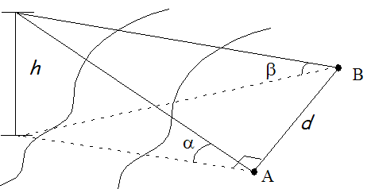

Computing the Height of a Pole
alphaRad = Math.toRadians(alpha);
betaRad = Math.toRadians(beta);
height = ( distance * Math.sin(alphaRad) * Math.sin(betaRad) )
/
Math.sqrt( Math.sin(alphaRad + betaRad) *
Math.sin(alphaRad - betaRad) );
Notes:
Here’s one sample showing how the given mathematical formula is written using the Math class methods. The formula computes the height of a statue given the distance between the two measuring points A and B.

Slide 46
Random Number Generation
We can use the nextInt(n) method of the Random class to generate a random number between 0 and n-1, inclusive.
import java.util.Random;
. . .
Random random = new Random();
. . .
int number = random.nextInt(11); //return x, 0 <= x <= 10
To return a random integer in [min, max] inclusively, where min <= max
. . .
int number = random.nextInt(max – min + 1) + min;

Slide 47
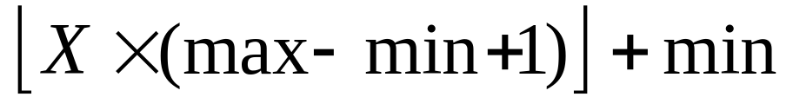
Random Number Generation (Cont’d)
The Math.random method is called a pseudo random number generator and returns a number (double) X, where 0.0 <= X < 1.0
To return a pseudo random integer in [min, max] inclusively, where min <= max, use the formula
int randomNumber = (int) (Math.floor(Math.random()
* (max – min + 1)) + min);

Slide 48
The GregorianCalendar Class
Use a GregorianCalendar object to manipulate calendar information
GregorianCalendar today, independenceDay;
today = new GregorianCalendar();
independenceDay
= new GregorianCalendar(1776, 6, 4);
//month 6 means July; 0 means January
Notes:
When you print out a double value, you may get eight or nine decimal places. To limit the number of decimal places to display, you can use the DecimalFormat class.

Slide 49
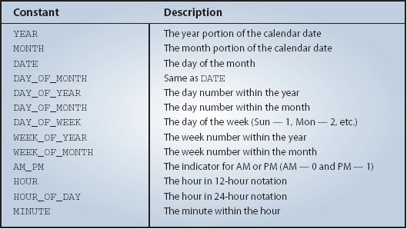
Retrieving Calendar Information
This table shows the class constants for retrieving different pieces of calendar information from Date.
Notes:
We can use these class constants to retrieve different pieces of calendar information. We use the get method and pass the desired constant as an argument.
The next slide shows a sample use.

Slide 50
Sample Calendar Retrieval
GregorianCalendar cal = new GregorianCalendar();
//Assume today is Dec 18, 2008
System.out.print(“Today is ” +
(cal.get(Calendar.MONTH)+1) + “/” +
cal.get(Calendar.DATE) + “/” +
cal.get(Calendar.YEAR));
Output
Today is 12/18/2008
Notes:
Here’s a sample code. Notice that we need to add 1 to the returned Month, because internally, January is represented as 0, February as 1, and so forth.

Slide 51

Lets Do Exercises!!!

